Slide 1
Creation of a New Undergraduate Teaching Session – Improving Preparation and Transition to Foundation Doctor HEENW SAS Conference 17th October 2019
Dr Deborah Saleh
Specialty Doctor Paediatrics
Royal Bolton Hospital

Slide 2
Contents
The problem
Designing a new session for Paediatrics medical students
Developing a session for FY1 induction programme
Results
Further developments
What I’ve learnt
Growth as an SAS Doctor

Slide 3
The Problem
Literature Review shows newly-qualified Doctors: (Brennan, 2010)
Do not feel well-prepared to deal with acutely unwell patients
Can struggle with clinical reasoning and decision-making
Known improvements: Increasing undergraduate clinical experience
Opportunities to ‘act up’ to Foundation Doctor role
Reduced duration of Paediatrics clinical placement
3. Powerpoint tutorial-based teaching programme

Slide 4
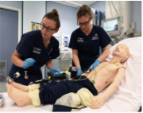
Designing My New Teaching Session
Tell me and I will forget,
Show me and I may remember,
Involve me and I will understand
Xun Zi (c312–230 BCE)
Benefits of Simulation-based Learning
Active participants
Students can ‘practice’ medicine, without risk to real patients
‘Contextualise’ learning material
‘Hands on,’ Handling real equipment
Used less often in undergraduate teaching

Slide 5
Designing My New Teaching Session
Clinical Scenario-based with Integrated ‘FY Doctor- type’ Complementary Tasks
Common acute presentation – Acute Asthma
‘Realism crucial to encouraging engagement with simulation’ (Hogg, 2016)
Structured Clinical A-E Assessment
Integrated Tasks
Prescribing, Practical skills, Interpreting and acting upon results, Calling for help, Structured handover, Clinical documentation
Lesson Plan, Learning Outcomes aligned with Curriculum

Slide 6
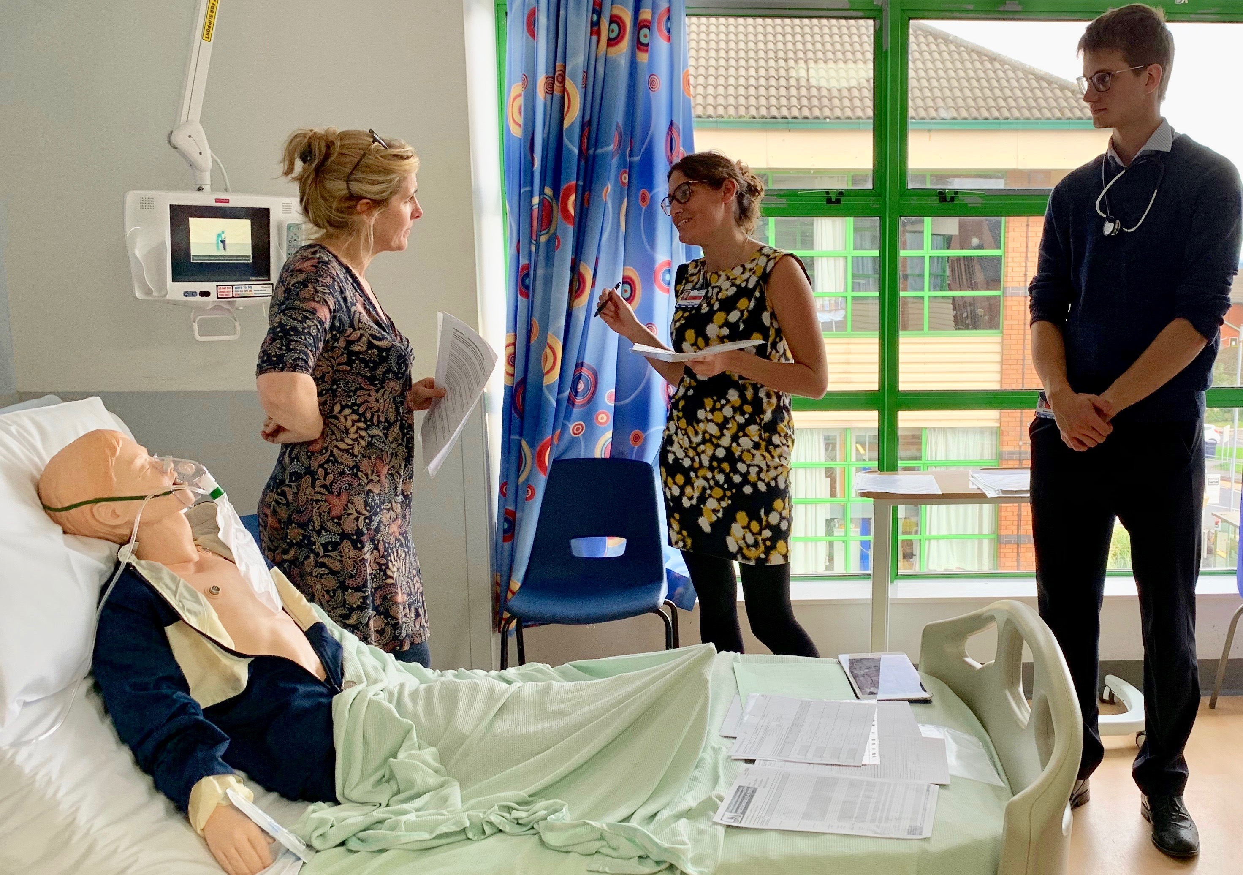
Method
Pre and Post-Session Questionnaire (ten-point scale)
Confidence with Clinical learning outcomes
Comparison of pre/post scores → Perceived educational impact of session
Quality of learning experience
Open responses
Data Collection - Feb-Oct 2019
5 groups, N=19

Slide 7
Medical Student Results
12% increase
10% increase
N=19
Rating scale 1-10 where 1 is least and 10 is most

Slide 8
Paediatric Junior Doctors Results
39% increase
59% increase
48% increase
24% increase
34% increase
8% increase
N=9
Rating scale 1-10 where 1 is least and 10 is most

Slide 9
Nurse Associates Results
16% increase
17% increase
27% increase
18% increase
49% increase
4% increase
N=5
Rating scale 1-10 where 1 is least and 10 is most

Slide 10
Developing a Session for FY1 Induction
Presented at Grand Rounds in May 2019
Plan - Design a new session for FY1 Induction programme August 2019
Challenges
Much larger group
Facilitators
Setting
Adults
Develop new scenarios

Slide 11
Developing a Session for FY1 Induction
2 x 2.5hr sessions, one week apart – 20 FY1s per session
Session divided into two halves - Simulation / Tutorial
Recruitment of 27 facilitators
Clearly defined session aims
Simulation
Tutorial
Pre and Post session questionnaires
Facilitator feedback

Slide 12
FY1 Results
33% increase
44% increase
33% increase
21% increase
1% increase
N=32
Rating scale 1-10 where 1 is least and 10 is most

Slide 13
Facilitator Feedback
Job Role | Number
Consultant | 5
Middle Grade | 5
FY3+ | 5
FY2 | 10
Other | 2
N=27
Rating scale 1-10 where 1 is least and 10 is most

Slide 14
Further Developments of My Teaching Session
Regular Paediatrics student timetable
Paediatrics Junior Doctor Induction
FY1 Induction programme 2020
Multidisciplinary sessions

Slide 15
What Has This Project Taught Me?
Little idea initially – grows!
Push outside of ‘comfort zone’
Management and organisational skills
Involve others
Well supported
Growth and development as SAS Doctor
My advice for other SAS Doctors

Slide 16
Thank You for Listening
“There is no replacement for a passionate teacher.
Medicine, like religion, is not taught but caught.”
(Dr John Collins, Dean of Education, Royal Australasian College of Surgeons)
Any Questions?
Contact: deborahsaleh@gmail.com
Many thanks to my Consultant Supervisor - Dr S Glass

Slide 17
References
Andreou, S., Williams, N. and Ganapathi, J. (2016). G91(P) What are the barriers to developing a paediatric multidisciplinary team in-situ simulation programme?. Archives of Disease in Childhood, 101(Suppl 1), pp.A53-A54.
Brennan, N., Corrigan, O., Allard, J., Archer, J., Barnes, R., Bleakley, A., Collett, T. and de Bere, S. (2010). The transition from medical student to junior doctor: today’s experiences of Tomorrow’s Doctors. Medical Education, 44(5), pp.449-458.
Hogg, G. and Miller, D. (2016). The effects of an enhanced simulation programme on medical students’ confidence responding to clinical deterioration. BMC Medical Education, 16(1).
Kirkpatrick, D. and Kirkpatrick, J. (2009). Evaluating Training Programs. San Francisco: Berrett-Koehler Publishers.
Okuda, Y., Bryson, E., DeMaria, S., Jacobson, L., Quinones, J., Shen, B. and Levine, A. (2009). The Utility of Simulation in Medical Education: What Is the Evidence?. Mount Sinai Journal of Medicine: A Journal of Translational and Personalized Medicine, 76(4), pp.330-343.

