Slide 1
Withdrawing Nutrition and Hydration at the End of Life
Dr Rachel Taylor
ST4 Palliative Medicine

Slide 2
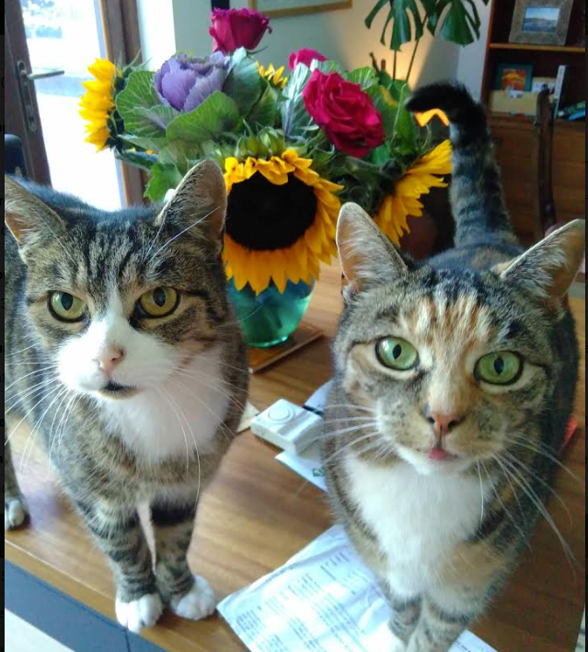
Objectives
Case study and decision making
BMA Guidance: Clinically-assisted nutrition and hydration (CANH)
Scope of guidance
Best interest decision making
Key principles

Slide 3
Curriculum Items
7.2 Theoretical Ethics and Applied Ethics in Clinical Practice of Palliative Medicine
8.2 Legal Framework for Practice

Slide 4
Case Study: MD
Background
Relapse-remitting MS
Epilepsy
Cognitive impairment: Baseline GCS E4 M5 V1
Bilateral PE and DVT
Hyperthyroidism
Cortical visual atrophy
Recurrent UTIs
Community DNAR in place

Slide 5
Notes:
Decisions to start, re-start, continue or stop CANH in adults in England and Wales who lack the capacity to make the decision for themselves.

Slide 6
BMA Guidance: Clinically-assisted nutrition and hydration (CANH)
Created from focus group in July 2018, updated September 2019
Representatives from BMA, RCP and GMC and a number of experts appointed to advise the group, as well as families of people who had made these decisions
Dr John Chisholm CBE, Chair of BMA Medical Ethics Committee (Chair of the Core Group)
Sharon Burton, Head of Standards and Ethics, GMC
Ruth Campbell, Senior Policy Advisor (Medical Ethics and Human Rights), BMA
Dr Chris Danbury, Consultant in Anaesthetics and Intensive Care
Veronica English, Head of Medical Ethics and Human Rights, BMA
Professor Celia Kitzinger, Co-Director, Coma and Disorders of Consciousness
Dr Shuli Levy, Consultant Geriatrician and General Physician
Paul McGough, Senior Associate (Healthcare Regulatory Team), DAC Beachcroft
Alex Ruck Keene, Barrister, 39 Essex Chambers
Professor Lynne Turner-Stokes MBE, Consultant in Rehabilitation Medicine,
Jessica Watkin, Policy Manager (Standards and Ethics), GMC

Slide 7
Why Separate CANH Guidance?
Since 1992 CANH is a medical treatment and NOT basic care
Some people attach symbolic, emotional or ethical significance that sets it apart from other forms of life sustaining treatment
Until 2017, all decisions to withdraw CANH from Vegetative State (VS) or minimally conscious state (MCS) had to be authorised by the court of protection
In 2018 Supreme court ruled if there’s agreement as to what constitutes best interests for the patient and capacity act and good practice guidelines are followed - no authorisation required
Notes:
To provide reassurance to those close to patients and the wider public, some additional levels of scrutiny have traditionally been
applied to these decisions.
CANH is not fundamentally different from other forms of life-sustaining treatment, but, because of this history, the changing legal position and the additional scrutiny of these decisions required by the GMC, we have made the decision to produce separate guidance on CANH

Slide 8
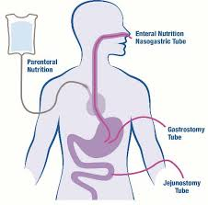
Scope of guidance
CANH refers to all forms of tube-feeding (NG/PEG/PN)
Is a tool to inform and aid decision-making.
It does not provide easy answers, but offers an approach through which an appropriate decision may be reached.

Slide 9
Decision makers must start from the strong presumption that it will be in the patient's best interests to prolong life

Slide 10
Balancing Human Rights
Right to life
Right to autonomy
Right to self determination - can outweigh the right to life if it’s known with sufficient certainty that continuing treatment would not provide a QOL the patient would find acceptable
Rights of patients to be treated with dignity and respect
Notes:
The right to self-determination is the right of a people to determine its own destiny. In particular, the principle allows a people to choose its own political status and to determine its own form of economic, cultural and social development.

Slide 11
Focus Population
Patients who could go on living for some time if CANH is provided, where CANH is the primary life-sustaining treatment. It covers patients with:
Previously healthy patients who are in a VS or MCS following a sudden-onset brain injury.
Neurodegenerative conditions
Multiple comorbidities and frailty which is likely to shorten life expectancy, who have suffered a brain injury
Notes:
This guidance extends beyond the patient group that was previously the subject of applications to the Court of Protection
Neurodegenerative: PD , Huntington's and dementia
Co-morbidities/frail: catastrophic stroke, traumatic/hypoxic brain injury, CNS infection, SDH, post brain surgery

Slide 12
Does Not Cover
Patients for whom CANH is not clinically indicated
Patients who are expected to die within hours or days
Patients for whom a decision to stop or not start CANH is part of a broader decision about life-sustaining treatment, e.g. mechanical ventilation.
Notes:
Not indicated:
not possible to provide it (pohysically impossible to insert tube, patient keeps removing it)
Risk too great - mortality from PEG/RIG insertion or high risk of aspiration
No clinical benefit and would carry potential risks

Slide 13
Other Considerations
Courts have made clear there is no legal or moral difference in withdrawing or withholding CANH
Some jurisdictions refer to withdrawing or withholding life sustaining treatment as ‘passive euthanasia' - this is not the position of the UK

Slide 14
Part one: general guidance for all decisions about clinically-assisted nutrition and hydration (CANH)
Notes:
All decisions about CANH for a patient who lacks capacity must be made in line with the Mental Capacity Act 2005.
protects patients by ensuring that decisions are made about treatment and care that are right for each individual, in the widest sense. protects doctors by providing protection from liability in relation to the decisions they make, but only when the correct decision-making process has been followed.

Slide 15
Flowchart

Slide 16
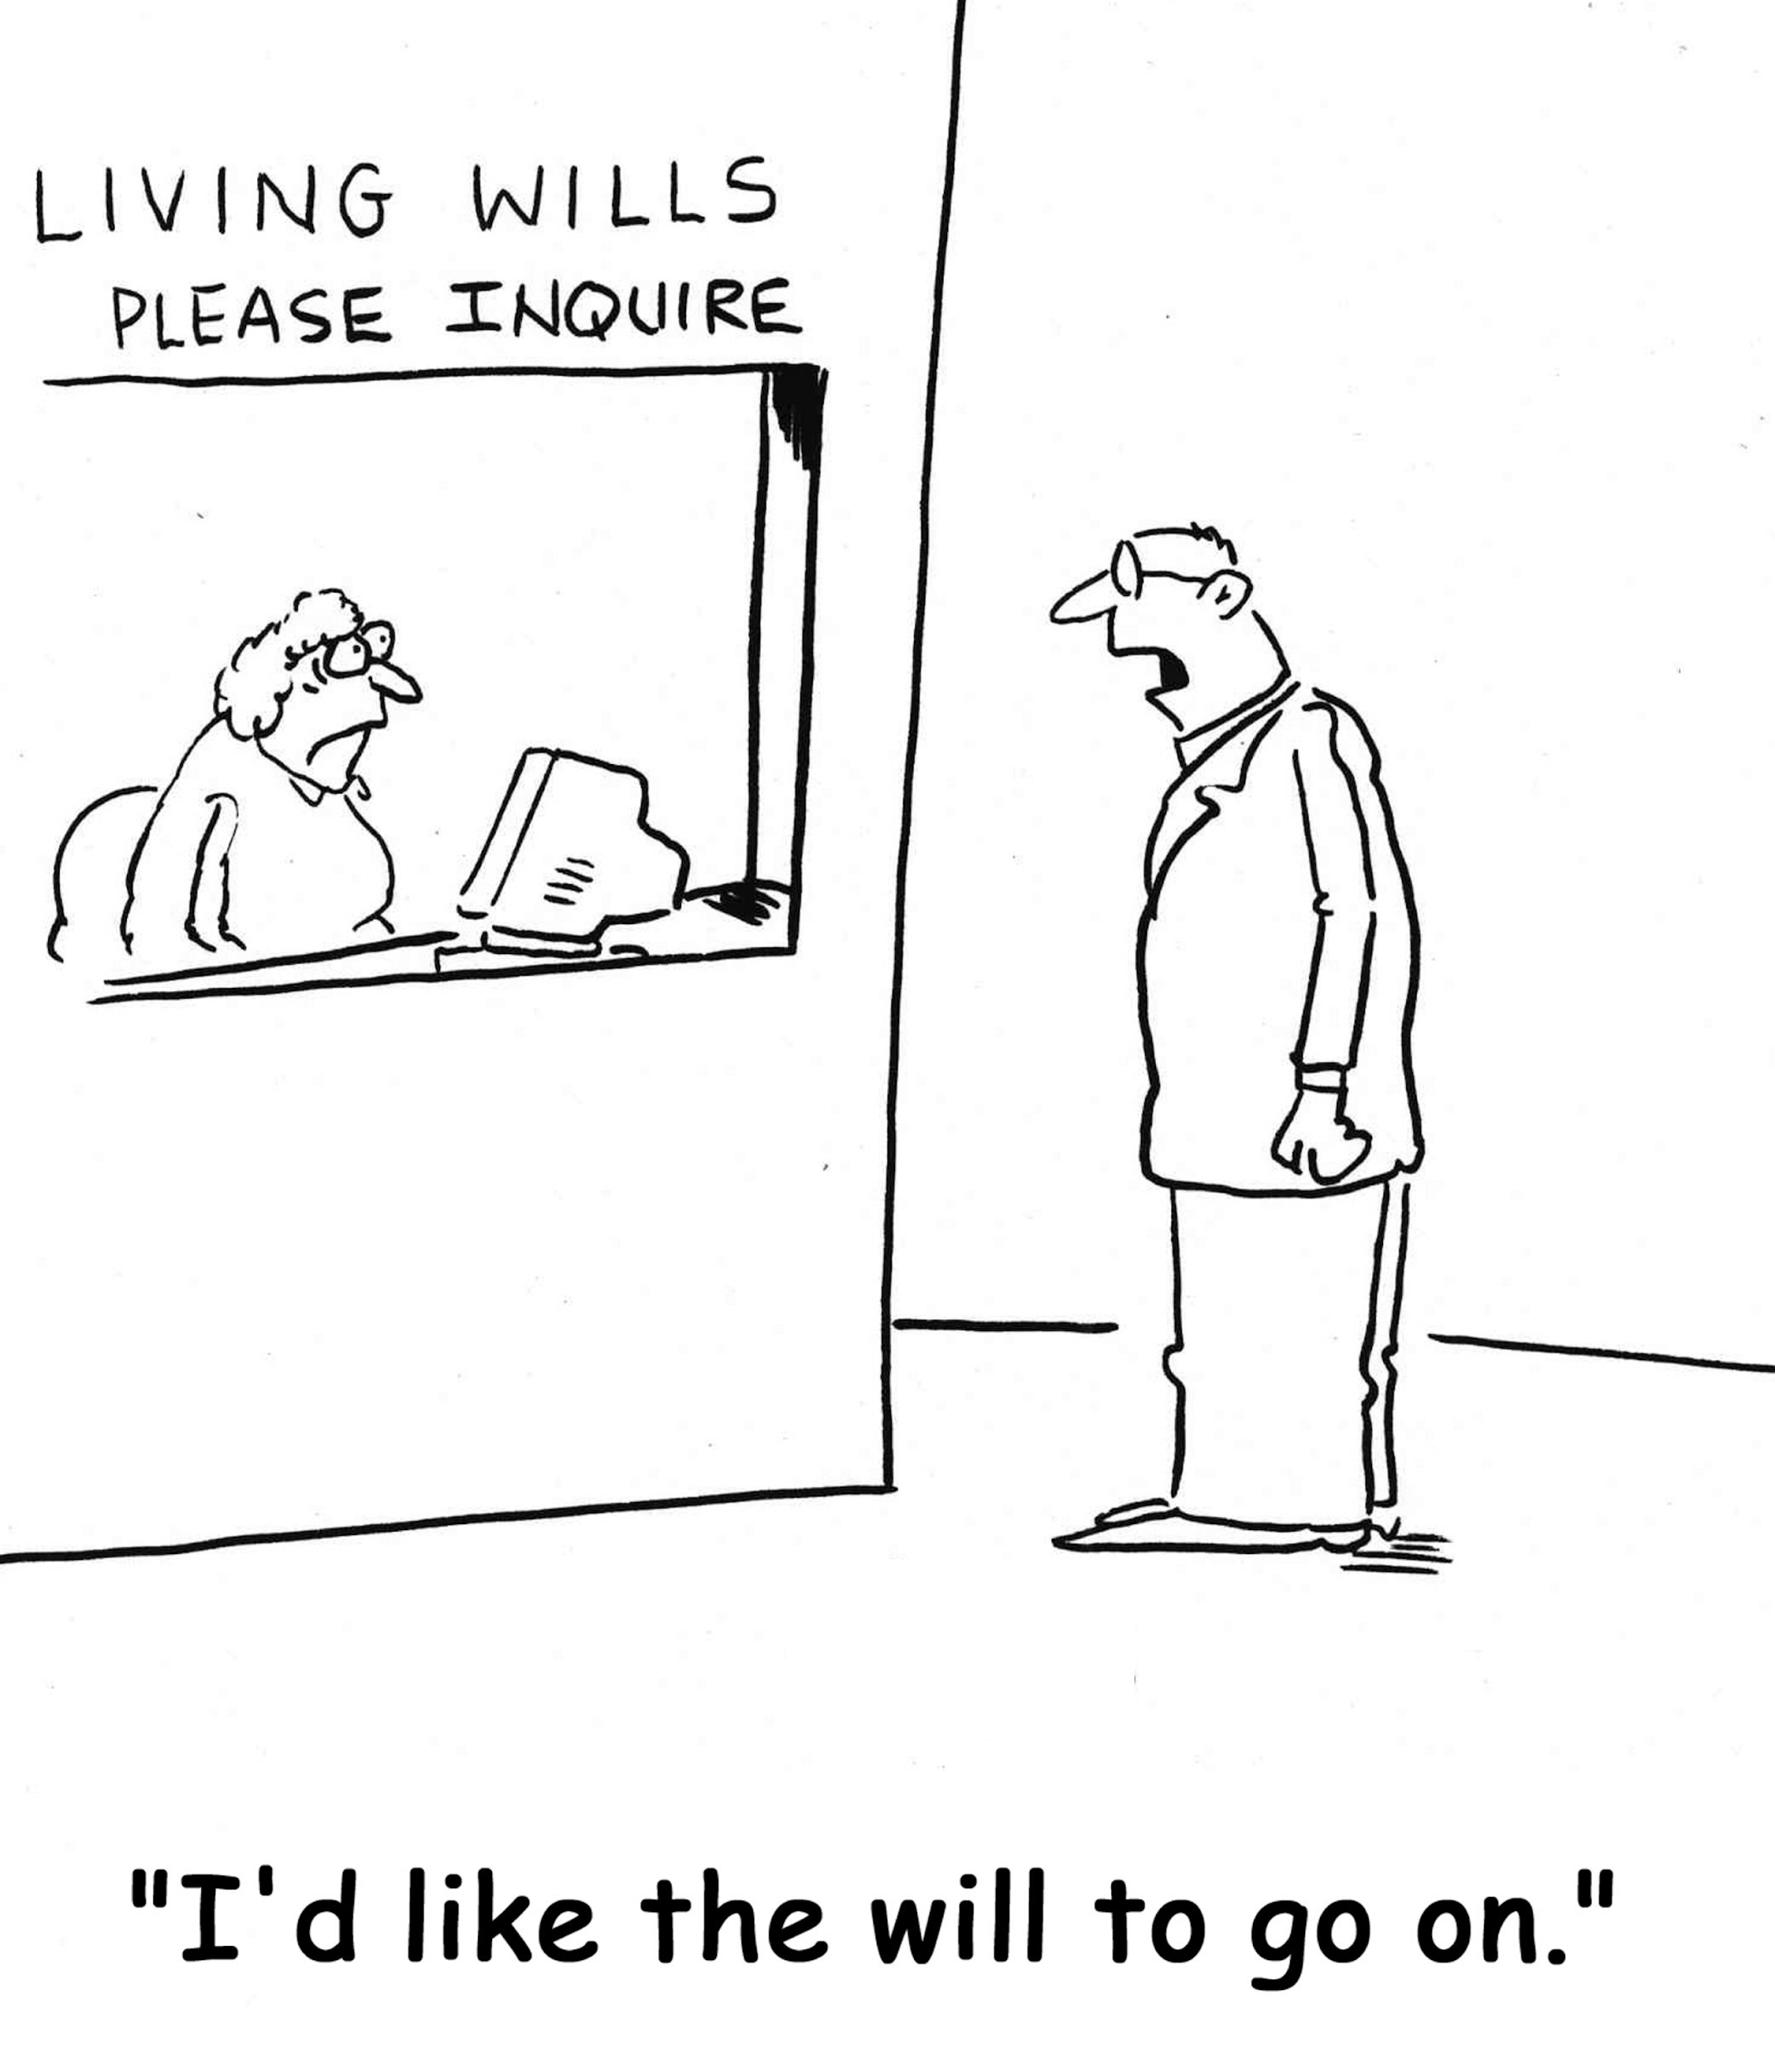
Advanced Decision to Refuse Treatment
Presume that a patient had capacity when the ADRT was made, unless there are grounds to believe otherwise.
Where there is genuine doubt about the capacity of the patient at the time, or the validity or applicability of an ADRT, legal advice should be sought, and an application to the Court of Protection may be needed.
An ADRT that does not meet the criteria to be legally binding must be considered as part of the best interests assessment
Notes:
When adult patients with capacity make an ADRT, they do not need to make what others perceive to be a wise decision.
The fact that the healthcare team and/or the family do not agree with the decision made does not mean that the patient lacked capacity or that the decision can be overruled or set to one side.

Slide 17
Health and Welfare Lasting Power of Attorney
Power to consent to or refuse lifesaving treatment - they are the lawful decision-maker
Must follow the principles of the MCA when making decisions and act in the patient’s best interests. This will involve them carrying out a best interests assessment and consulting with carers, family members and others interested in the patient’s welfare.
If clinical team has proper grounds to doubt them
discuss the matter further with the health and welfare attorney and seek to resolve the issue.
If disagreement or doubt persists about whether the attorney is acting in the best interests of the patient, the Court of Protection should be asked to decide.
Notes:
If an ADRT is made refusing CANH, after a health and welfare attorney is appointed, the ADRT takes precedence

Slide 18
Clinician-led decision-making
Best interests discussions begin at an early stage and continue over time, they include:
Informal discussions
Information sharing
Formally recorded meetings
Should include an initial discussion about the views, beliefs, wishes, feelings and values of the patient
The aim is for the decision-maker to have sufficient knowledge about the patient to make a judgement about whether CANH would be in the patient’s best interests
Alongside discussions about wider care
Notes:
In reality these decisions will be made as one part of an overall plan for care and treatment, as part of an ongoing dialogue. This may also involve decisions about ceilings of treatment or intervention, such as whether antibiotics should be provided if the patient develops an infection, as part of an ongoing dialogue.

Slide 19
Who is responsible for making decisions?
Ideally be made and agreed by the whole of the treating team and those close to the patient.
It should be established clearly, at all times, who has formal decision-making responsibility
In hospital – the named consultant
In a hospice/palliative care unit – the named consultant or senior doctor with overall clinical responsibility for the patient’s care.
In the community (in a nursing or care home or living at home) – the patient’s general practice

Slide 20
Who should be involved in decision-making?
MCA: those ‘engaged in caring for the patient or interested in his or her welfare’ should be consulted as part of best interests decision-making.
Anyone named by the individual as someone to be consulted on such matter
Anyone engaged in caring for the patient or interested in his or her welfare
Any court-appointed deputy
If none of the above - an IMCA must be consulted
The MDT
Local palliative care team - can inform on discussions around the withdrawal process
Notes:
The second of the categories above is potentially very broad and open to interpretation. How extensive this consultation should be will depend on what is ‘practicable and appropriate’ in the individual circumstances and should be proportionate to the consequences of the decision being made
The person responsible for making the decision should ultimately decide how wide this consultation should be, but should take account of the views of other members of the healthcare team in reaching that decision.
The decision of who to consult must not be influenced by a desire to achieve agreement on a particular course of action.

Slide 21
Proportionality
How extensive this consultation should be will depend on what is ‘practicable and appropriate’ in the individual circumstances
Should be proportionate to the consequences of the decision being made
Includes the certainty with regards to prognosis
Consequences of making a ‘wrong’ decision
Notes:
‘wrong ‘ decision could be carrying treatment on too long or withdrawing it too early.

Slide 22
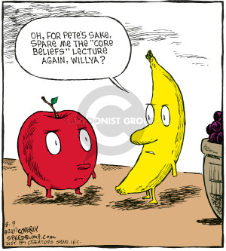
The type of information to be considered
Assume the patient would want relevant information shared with those who may be asked to contribute to the decision-making process.
Provide accurate and factual information, in a way those close to the patient can understand
Those close to the patient should provide information about the patient as a person, what he or she was like before the injury, interests, beliefs, feelings, values
Collect written statements from people close to the patient
Notes:
Prognosis with/without CANH, process of withdrawal including EOLCP
Including whether they think the patient would want CANH to be provided and why they think that

Slide 23
Personal information
What the patient was like before becoming ill – work, hobbies, likes, dislikes, what was important to them etc.
Examples of things the patient said or did that might indicate the view that they are likely to have of their current situation
Anything relevant the patient wrote down – in a diary, letters, on social media or in e-mails
Religious, spiritual or ethical beliefs the patient held and how these might impact on the decision
Aspects of the patient’s personality

Slide 24
Example from the Courts
‘Prior to his injury he told his cousin that he did not agree that people should be assisted to die, and that a life was no less valuable or worth living if a person was chronically disabled or ill. P was a deeply religious man. He strongly believed that life was sacred given by God and could only be taken away by God. As a Sunni Muslim he believed that suffering was a component of predestination and someone else should not play an assisting role in shortening life merely because of the subjective quality of that life. It is against the tenet of his faith to do anything to shorten a life… All these matters point strongly towards P wishing to ensure that life preserving treatment should continue whatever may befall him.’71 Mr Justice Newton, St George’s Healthcare NHS Trust v P, 2015

Slide 25
Example from the Courts
SL told me he recalls a conversation with his mother in which she had told him expressly that she would not wish to be ‘kept alive artificially’. By that time she had had first-hand experience of the death of a good friend who had passed away in a local hospice. She told him: ‘If I can’t have a full life, I just want to go’.’74 Mr Justice Cobb, PL v Sutton Clinical Commissioning Group, 2017

Slide 26
Clinical assessments
What is his/her current condition?
What is the quality of his/her life at present?
What is his/her awareness of the world around him/her?
Is there any (or any significant) enjoyment in his/her life? If so, how can this be maximised?
Does he/she experience pain and/or distress and if so, is it appropriately managed?
What is his/her prognosis, if CANH were to be continued?
Is there any real prospect of recovery of any functions or improvement to a QOL that he/she would value?
What is the prognosis if CANH were to be discontinued? – What would the palliative care package include?

Slide 27
‘Palliative Care Package’
Where and how will end-of-life care be provided?
What principles will inform care?
Where will the patient be cared for?
Which doctors will lead on providing end-of-life care?
Has a palliative care doctor been involved in discussions and decision-making?

Slide 28
Balancing the information
Assessing best interests in relation to CANH can be complex, involving the balancing and weighing of a range of divergent and competing factors – both clinical and personal.
A ‘balance-sheet approach’ can help to ensure that all relevant factors have been carefully considered and to demonstrate how the decision has been reached.
It is the weight of the arguments, rather than the number on each side, which assists in identifying what is in the patient’s best interests.
‘Factors of magnetic importance’.

Slide 29
Record keeping
How the decision about the patient’s best interests was reached
What the reasons for making the decision were
Who was consulted to help work out best interests
What particular factors were taken into account
Family members who didn’t want to be involved - people it is ‘not practicable or appropriate to consult’.
Can use a ‘checklist of evidence for best interest decision making’

Slide 30
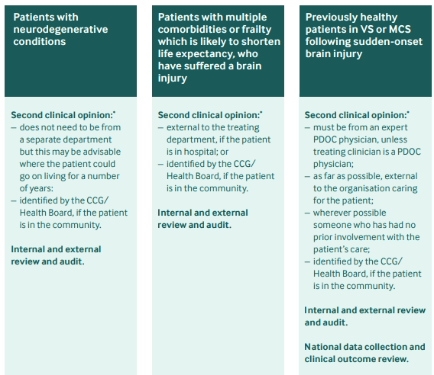
Second opinion
If the patient is not expected to die within hours or days:
“take all reasonable steps to get a second opinion from a senior clinician”
Notes:
– have relevant clinical knowledge and experience;
– have experience of best interests decision-making;
– be able to act independently

Slide 31
Managing disagreement/uncertainty
Conflict resolution
IMCA
Second opinion
Case conference
Mediation
Court of protection

Slide 32
Decision to withdraw
All relevant parties agree to withdrawal
Carefully planned end-of-life care
Does not mean withdrawal of all other care
Supporting family members and staff
Record-keeping
Review and audit

Slide 33
Decision to treat
Commenced on a trial basis
Reviewed every 6 months
Ensure organisations providing CANH comply with the law
CCGs/Health boards form a standard part of the annual review

Slide 34
Health professionals with a conscientious objection
There is no statutory right
A health professional should recognise the conflict of interest and handover this element of the patients care
Personal views should not influence the way in which clinical information is presented
Provider organisations that carry religious or other convictions that would prevent them from making and implementing particular decisions about CANH should declare that fact
Notes:
best interests assessments about CANH to be carried out in, or by staff from, another establishment.

Slide 35
Part two: guidance for specific scenarios
Decisions about clinically-assisted nutrition and hydration (CANH)
In the context of neurodegenerative conditions
In patients with multiple comorbidities or frailty which is likely to shorten life expectancy, who have suffered a brain injury
In previously healthy patients in vegetative state (VS) or minimally conscious state (MCS) following a sudden-onset brain injury

Slide 36
Six Key Principles
CANH is a form of medical treatment.
Treatment should only be provided when it is in the patient’s best interests.
Decision-makers must start from the strong presumption that it is in a patient’s best interests to receive life-sustaining treatment – but that presumption can be rebutted.
All decisions must be made in accordance with the MCA.
There is no requirement for decisions to withdraw CANH to be approved by the Court.
A second opinion must be sought when a patient is not within hours or days of death.

Slide 37
Any Questions?

