Slide 1
NHS England (North-West)
Core Psychiatry Induction
Presented by:
Teresa Guy, Programme Support Officer
Notes:
Hi everyone, my name is Teresa Guy and I am the Programme support Officer for Psychiatry. Today I am going to run through some important points you will need to know throughout your training.

Slide 2
NHS England
(working across the north west)
At NHSE, our purpose as part of the NHS, is to work with partners to plan, recruit, educate and train the health workforce.
We have responsibility for over 7,000 Resident Doctors
Our Priority – to ensure that our doctors are confident in providing high quality patient care, supported by excellent trainers.
Dr Roisin Haslett is the Postgraduate Dean and your Responsible Officer.
Dr Sameer Misra is the Associate Dean for Psychiatry.
Notes:
10 year plan, upcoming people plan.

Slide 3
School of Psychiatry Overview
The administration team is based at Regatta Place, Liverpool​. ​Please use the generic email address when contacting the team: england.psychiatry.nw@nhs.net
TITLE |  | EMAIL
Associate Dean |  | Sameer.misra1@nhs.net
Head of School |  | hannah.cappleman2@nhs.net
Associate Head of School |  | Seri.abraham@nhs.net
Training Programme Directors | Mersey Care Alder Hey & CWP E Lancs /Lancs Cares GMMH MFT,Pennine Care & ACFs | MER - declan.hyland@merseycare.nhs.uk MER - rajashekhar.madgula@merseycare.nhs.uk LANCS – katy.mason@lscft.nhs.uk NWN - Emily.Mountain@gmmh.nhs.uk NWN - kripa.ullal@gmmh.nhs.uk NWN - roshelle.ramkisson2@mft.nhs.uk Core Medical Psychotherapy – kathia.sullivan@nhs.net Health & Wellbeing – neelo.aslam@mft.nhs.uk Exam Support - roshelle.ramkisson2@mft.nhs.uk & amit.sindhi@gmmh.nhs.uk
Programme Support Manager |  | Natalie Dawson
Programme Support Co-ordinator |  | Lindsey Robinson
Programme Support​ |  | Teresa Guy/ Alex Cooper
Notes:
The administration team are based at Regatta Place, Liverpool. We please ask for you to use our generic email address above to contact us for any queries.
In the table you will also see key contacts for the School.

Slide 4
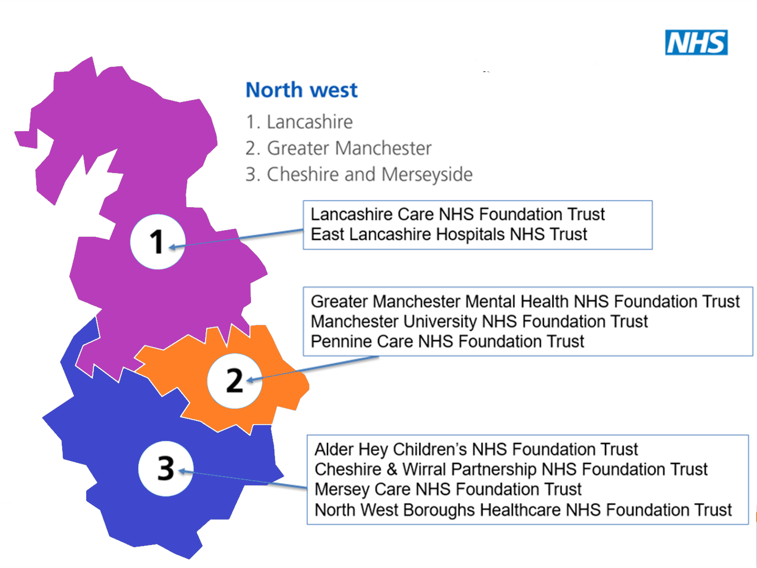
Notes:
The North West School of Psychiatry is split across three different reigions, Lancashire, Greater Manchester, and Cheshire and Merseyside.

Slide 5
Programme Support - What we do
New Starter Arrangements: New starters are contacted to complete a New Starter-Form R on the TIS self-service portal and an NTN/DRN is created upon submission. You are responsible for adding this to eportolfio.
In the first 18 months of Core training, you must take the following placements:
1 x 6 months General Psychiatry In-Patient
1 x 6 months General Psychiatry CMHT/Out-Patient
1 x 6 months Old Age Psychiatry.
Rotations: The team will provide rotations to the Lead Employer (LEO) 14 weeks prior to the rotation. (All rotations are subject to change due to unknown factors such as assessment and Occupational Health requirements).
  LEO will inform Resident Drs of their placement 12 weeks prior to the rotation. Any queries, please contact: lead.employer@merseywestlancs.nhs.uk
  Host Trust will advise you on your rota 8 weeks prior to the rotation.
Notes:
Now I am going to run through what we do within the programme support team and how we can help you.

Slide 6
Annual Review of Competence Progression (ARCP)
Assessment Panel (ARCP)– Panel reviews E-Portfolio and awards an outcome based on the evidence provided. ​​
​​
​​
Feedback Panel – Resident Drs who are awarded development outcomes are invited to discuss training and support required. ​​
​​
​​
Educational Review: Any Resident Drs who receive an Outcome 2 at their annual ARCP will be required to have an Educational review 6 months after their initial ARCP with their educational supervisor to review SMART objectives and progress.
Notes:
Our team are also responsible for the organisation and running of ARCP’s, They have the following split

Slide 7
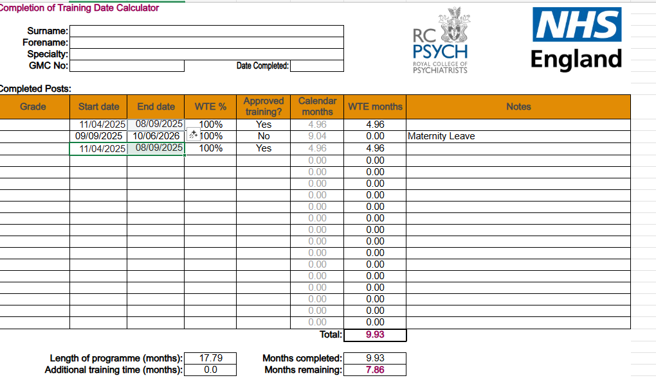
Annual Review of Competence Progression (ARCP)
ARCPs ensure that all competencies and elements of the curriculum have been met to progress to the next year of training
The Programme Support Team organises ARCPs across the year. Any queries to england.psychiatry.nw@nhs.net
Required to have an annual ARCP as per the Gold Guide.
Less than full time (LTFT) doctors may have more than one depending
on progression dates.
(refer to your CCT calculator)
Your first ARCP will be Summer 2026. Confirmation of the exact date will be sent from england.psychiatry.nw@nhs.net 6 weeks prior. This will be held over MS Teams, and you are not required to attend. If required, you may need to attend a feedback panel Dates TBC
ePortfolio to be updated at least 5-7 days prior to this date.

Slide 8
ARCPs continued
Form R – need to be submitted before each ARCP. Mandatory for revalidation. Please complete the entire form at least 2 weeks prior to your ARCP Panel.
Keep us up to date with email address – not doctors.org
ARCP dates are uploaded in advance to our website. Please also refer to our website for ARCP Guidance https://www.nwpgmd.nhs.uk/Specialty_Schools/Psychiatry
Please ensure to read the Curriculum and the information on the Royal College of Psychiatry website https://www.rcpsych.ac.uk/training/curricula-and-guidance
Notes:
Plain slide with subhead and bullets

Slide 9
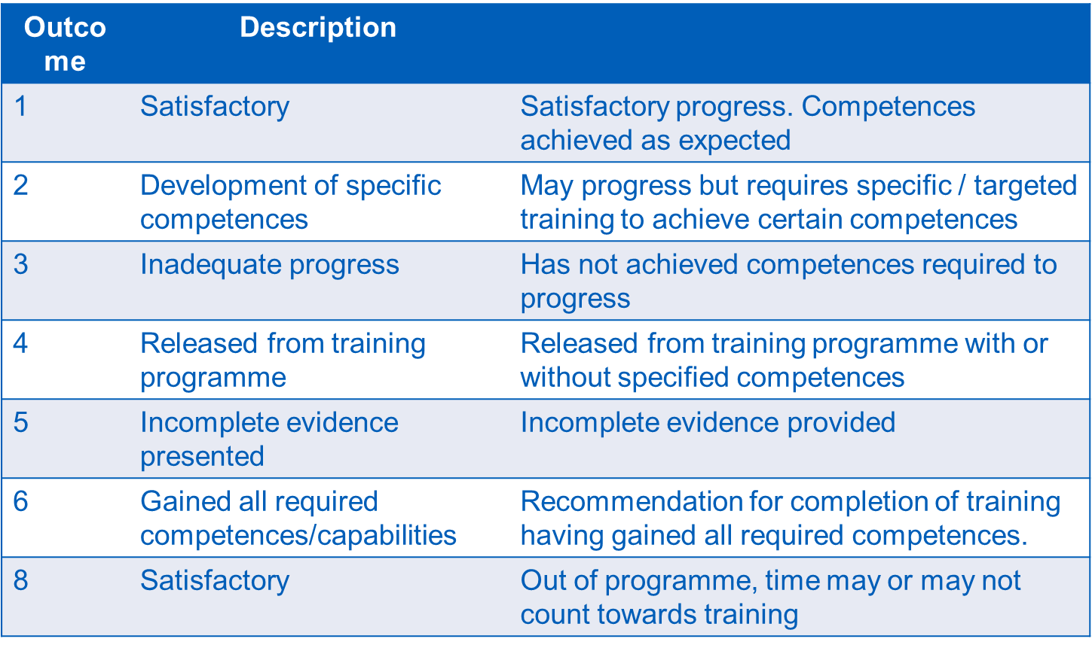
ARCP Outcomes
Notes:
Above are the list of ARCP outcomes you can receive.

Slide 10
ARCP Tips
Ensure Psychiatric Supervisor Report Core Psychiatry (2016) and the ARCP Educational Supervisor Summary Reports are available on the e-portfolio at least 2 weeks prior to the Assessment Panel​​
Ensure your Form R is submitted 6 weeks prior to the Assessment Panel ​​
Read the curriculum!​ Evidence cannot be used more than 7 times against the Higher Learning Outcome.​ ​
​
Ensure your Mini-PAT is released prior to the Assessment Panel
Notes:
Here are a few tips to follow on the lead up to the ARCP period

Slide 11
Who can help you?
Clinical and Educational Supervisor – training placement, health or personal issues, meeting competences, completion of training reports​​
Training Programme Director – rotation queries, training placement, ARCP advice, escalate concerns​​
​NHSE School of Psychiatry– ARCP advice, OOP/IDT/LTFT queries, CCT date in conjunction with RCPsych​

Slide 12
Occupational Health (OH) service
Access the service via the Lead Employer rather than the Host Trust
Please ensure you are referred via your Training Programme Director.
If you self-refer NHSENW and the TPD are not informed of outcomes of the OH meetings and any reasonable adjustments that may be required to support your training may be missed.
Notes:
I am now going to run through occupational health. This service is accessed via the lead employer rather than your host trust. It is important you are referred via your Training Programme Director.

Slide 13
Coaching and Mentoring Services
NHSENW can refer Resident Drs for Coaching and Mentoring with Westwood Coaching which is a confidential service.
Assists with:
Exam techniques
Time Management
Organisational Skills
Communication Skills
Please liaise with your TPD if you feel you require support and NHSENW can refer you.
Notes:
Plain slide with subhead and bullets

Slide 14
Professional Support & Wellbeing Service (PSW)
Support Resident Dr’s by offering the following:
Exam Support
Mentorship & Pastoral Support
Careers Support
Dyslexia screening via Genius Within Coaching
Neurodiversity screening via Genius Within Coaching
Referrals are made via either an ARCP panel, Educational Supervisor or Training Programme Director. Further details on referral criteria can be found here
Notes:
NHSE NW now also has a professional support and wellbeing service. The main aim of this is to better support Postgraduate Drs in Training within the North West.
Resources offered by the PSW Service include bespoke exam support and coaching with an educational Psychologist, Mentorship & pastoral support via an experienced PSW case manager, career support, dyslexia screening via genius within, Neurodiversity screening via genius within coaching.
Referrals are made via either an ARCP panel, educational supervisor or training programme director.
Refferal criteria includes any postgraduate Dr with an ARCP outcome 3 for reasons solely exam failure, any postgraduate Dr involved in whistleblowing or has raised a grievance and would like

Slide 15
NHSE NW Policies & Procedures https://www.nwpgmd.nhs.uk/policies-procedures
Out Of Programme (OOP)
For research, experience, training, career break and pause.
If the OOP is due to health reasons this will need to be supported by an OH report
You will need to apply a minimum of 6 months in advance.
Discuss your proposed intentions as early as possible with your Education Supervisor and TPD
If want to count any time towards training need to apply prospectively to the College and GMC.
Still need to submit documentation for ARCP despite being OOP.
Completed applications to be submitted to england.psychiatry.nw@nhs.net
Notes:
Now I am going to run through a few of our policies and procedures – starting with out of programme.

Slide 16
NHSE NW Policies & Procedures
Inter-Deanery Transfers (IDT)
A national process, run by London, with 2 windows per year ; usually for an August or February start.
Information on IDT can be found here
Study Leave
Please liaise with the Study Leave Coordinator with regards to your entitlement.
Pro rata for LTFT Resident Drs.
Please refer to our website for further details.
Enquiries to the Study Leave Team: england.studyleaveapplications.nw@nhs.net
Notes:
Next I am going to run through inter Deanery Transfers.

Slide 17
NHSE NW Policies & Procedures
Less Than Full Time (LTFT)
There is the option to train flexibly, with an eligibility criteria and application process to follow.
Now has 2 windows in which you need to apply, with an August or February start date. The period of LTFT must last a rotation period and cannot commence or finish mid-way through a rotation.
Can reduce your hours to between 50% and 80%.
Only when confirmation has been received from the LTFT Team will your change in hours be approved.
Working LTFT will affect your progression and rotation dates.
Enquiries to the LTFT Team: england.ltft.nw@nhs.net
Notes:
Plain slide with subhead and bullets

Slide 18
NHSE NW Policies & Procedures
Revalidation
Part of ARCP process and every 5 years, most will revalidate at CCT, some may revalidate part way through training dependent on the date they have been given by the GMC.
Information formed by Form R, LEO & Host Trust, Trainer’s Report
Will be revalidated with either causes of concern, or no known causes of concern
Roisin Haslett is the Postgraduate Dean and your Responsible Officer, NHSENW is your designated body.
https://www.nwpgmd.nhs.uk/revalidation
Notes:
Plain slide with subhead and bullets

Slide 19

Lead Employer Organisation (LEO)
The LEO is Mersey & West Lancashire Teaching Hospitals: Lead.employer@sthk.nhs.uk
LEO deals with all enquiries regarding:
Pay & Banding: leademployerpayroll@merseywestlancs.nhs.uk
Confirmation of employment
Travel expenses
Parental leave
Annual leave
Communication of rotational placements 12 weeks prior to placement start date
Click this link to view the Lead Employer Website and new starter video
Notes:
Plain slide with subhead and bullets

Slide 20
How Can You Help?
Form R: please complete as at the start of training and every ARCP Panel as this is required for revalidation
E-Portfolio: make sure this is up to date and well organised, and you sign ARCP forms
Personal details: You can now update your personal details on TIS Self Service if you amend your email address can you please also inform the Team of the change.
ARCP guidance: please read and follow the guidance and curriculum.
Notes:
Plain slide with subhead and bullets

Slide 21
Useful sites
Notes:
Plain slide with subhead and bullets

Slide 22
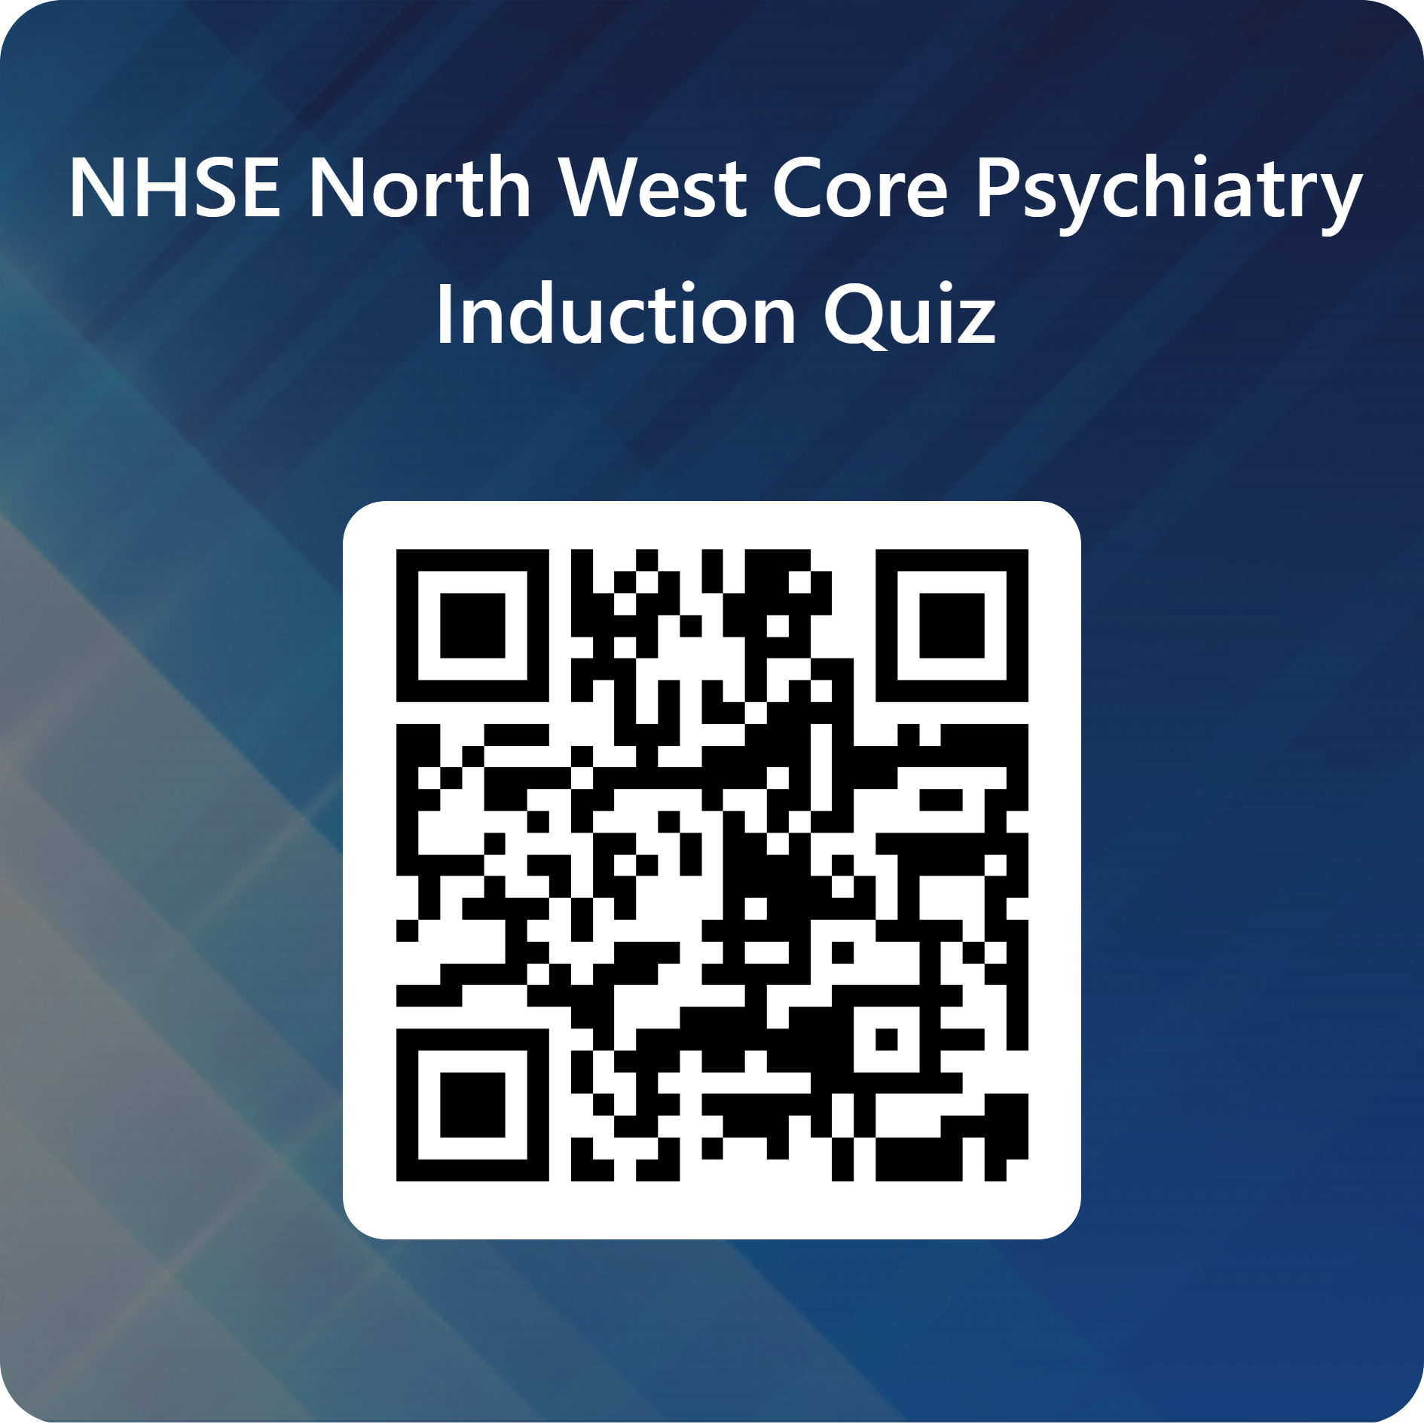

HAVE YOU BEEN LISTENING QUIZ
Notes:
Plain slide with subhead and bullets

Slide 23
End slide

