Slide 1
Hydronephrosis in palliative care patients
Marius Craciun
ST7 Urology, HENW Deanery

Slide 2
Objectives
Background
Guidelines
Options for decompression
Factors to help in decision making
Regional practice

Slide 3
Points to cover
Which patients should be referred to urology
Management options (and how the decision is reached from a urologist's point of view)
Complications of ureteric stents and nephrostomies; follow up considerations

Slide 4
Background
Malignant ureteric obstruction is a condition that affects patients with advanced stages of cancer.
An obstructed single system can significantly reduce patients’ quality of life especially if infection ensues; however, bilateral obstruction will lead to a certain death.
Often, when the malignant process affects the ureter, the resulting obstruction is very difficult to cure and can potentially require long-term decompression by drainage or diversion.
Ureteral stent insertion in the management of malignant ureteric obstruction can be linked to a high failure rate

Slide 5
Background
Upper urinary tract obstruction is a prognostic indicator of morbidity for many cancers.
Currently prostate and bladder cancer account for most urological malignancies.
Change from single discipline decision to multidisciplinary approach involving urologists, oncologists, palliative care team, general medicine and interventional radiologists.

Slide 6
Therapeutic goals of urinary drainage
Adequately drain the upper urinary tracts for symptomatic relief.
Maintain renal function, allowing the initiation of systemic therapy.
Minimising further intervention, hospitalisation and negative QoL

Slide 7
Guidelines
EAU, AUA and NICE - recommend decompressing the urinary systems, but there is a lack of consensus as well as strong evidence to support the decision process
NICE - patients should be offered decompression, but that the option of ‘no intervention should also be discussed’.
None of these recommendations take into consideration the implications of quality of life

Slide 8
Guidelines
EAU: it is good practice to drain symptomatic hydronephrosis and to drain only one kidney (the less dilated and better appearing kidney or the one with the better function, if known) in asymptomatic patients’
EAU: PCN is superior to a stent for drainage for pelvic malignancies but advocate either stenting or nephrostomies in other tumour groups,
But neither of these recommendations reference the literature nor do they mention implications of quality of life.

Slide 9
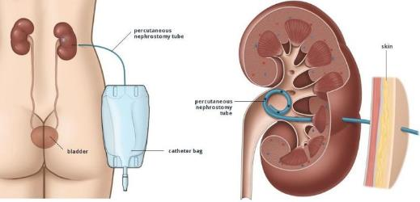
Options for decompression

Slide 10
Nephrostomy
Pros
More likely to improve and preserve renal function than stents (? better for younger patient requiring aggressive chemotherapy to improve survival)
Can be done under LA
Cons
Prone to blockages and can dislodge and needs reinsertion
Dressing care, can leak, source of infection (some oncologists don’t like them)
Ideally exchange every 3 months
Risks
Bleeding, bowel injury, failure

Slide 11
Ureteric stent
Pros
No external tubes / drains
Cons
Needs GA (most of the cases)
Needs exchange every 6-12 months
Stent related symptoms
Can get encrusted / blocked
Not very effective in extrinsic compression
Risks
GA risks
Failure to insert

Slide 12
Percutaneous nephrostomy OR STENT?
For benign disease (stone) – 3 trials – no difference
For malignant disease - not clear / not much data
PCN insertion has higher success rate compared to retrograde stenting in malignant ureteric obstructions, especially when urgent decompression is necessary

Slide 13
Metallic stents
Theoretical advantages of metal stents over polymer ones include reduced encrustation, improved tensile strength and stability, prolonged stent indwell time, and better flow
Despite the initial enthusiasm about metallic stents in the management of malignant ureteric obstruction, such stents are reported to have a failure rate of 38-48% in malignant cases
Liatsikos EN, Karnabatidis D, Katsanos K, Kallidonis P, Katsakiori P, Kagadis GC, et al. Ureteral metal stents: 10-year experience with malignant ureteral obstruction treatment.J Urol 2009;182:2613-7.

Slide 14
Metallic stents

Slide 15
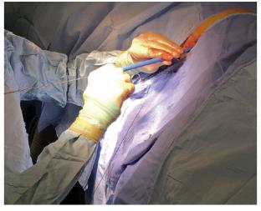
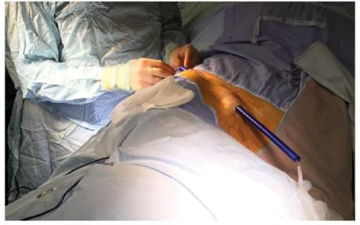
Extra- anatomical stents
Formation of an alternative passage for urinary drainage from the renal pelvis to the bladder using a tunnelled subcutaneous system, bypassing the ureter

Slide 16
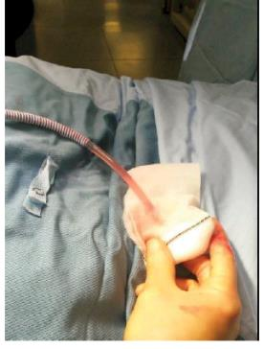
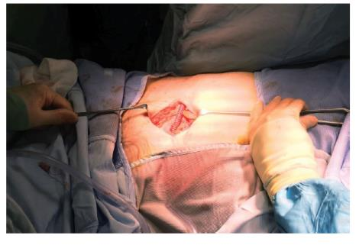
Extra- anatomical stents

Slide 17
Factors to help in decision making
Prognosis
Quality of life associated with the PCN or stent
Major and minor complications
Morbidity defined as hospitalisation post intervention
Further treatment

Slide 18
Factors to help in decision making

Slide 19
Prognosis
50 papers included prognosis as an outcome measure with n=2790 patients
21 h to 140 months with a median survival of 6.4 months
The mean of the percentage of patients surviving one year was 23%
Patients with a malignancy of unknown primary or gastrointestinal origin were identified as having poorer outcomes, whereas gynaecological malignancies had a better outcome.
Low albumin / no further treatment options / number of malignant related events (effusion, metastatic disease, ascites etc), PS 2 or more, low Na

Slide 20
Quality of life
Can be challenging to measure (how much is caused by obstruction and PCN or stent or other cancer features)
5 studies that used Grabstald outcome measure tool, n=167: 60% of patients were able to achieve a ‘useful life’ post decompression
4 studies – no difference in QoL between PCN and stent

Slide 21
Complications
Overall complication rate 41 %
26% PCN vs 14% stent had urinary infection (?urosepsis)
10% dislodged PCN, 7% blocked PCN
6% had stent migration
Haematuria 8% stent vs 3% PCN
0.2% had nephrectomy post PCN
0.2% mortality post PCN (other papers 5%)

Slide 22
Morbidity defined as hospitalisation post intervention
12 paper: 26% (range 5%-69%) - patients never left hospital post decompression
Also patients spent 20% of their remaining lifetime in hospital.
Effect on renal function: creat improved from 624 to 212

Slide 23
Regional experience / practice
Data from M Abdulmajed, C Seipp, I Shergill
North Wales – 3 hospitals
Jan 2012 – Feb 2016
70% of PCN were for malignancy (prostate and bladder most common cancers)
Immediate or late complications (median 14 days) – PCN failure in 8.4%
Stent failure (antegrade) - (median 40 days) – 17.7%
Mortality at 3 months 53% with no noticeable impact of age, performance status or change in renal function variables on survival

Slide 24
Conclusion
Multidisciplinary approach
Patients should be:
centrally involved in discussion and decision making.
fully aware of their disease stage and prognosis before making decision.
made aware of the facts and risks associated with renal decompression.

Slide 25
Questions?

Slide 26
Ku JH, Lee SW, Jeon HG, Kim HH, Oh SJ. Percutaneous nephrostomy versus indwelling ureteral stents in the management of extrinsic ureteral obstruc- tion in advanced malignancies: are there differences? Urology 2004;64: 895-9.
Feng MI, Bellman GC, Shapiro CE. Management of ureteral obstruction secondary to pelvic malignancies. J Endourol 1999; 13: 521-524.
Hyppolite JC, Daniels ID, Friedman EA. Obstructive uropathy in gynecologic malignancy. Detrimental effect of intraureteral stent placement and value of percutaneous nephrostomy. ASAIO J 1995;41:318-23.
Chang HC, Tang SH, Chuang FP, Wu ST, Sun GH, Yu DS, Chang SY, Cha TL. Comparison between the use of percutaneous nephrostomy and internal ureteral stenting in the management of long-term ureteral obstructions. Urol Sciences 2012;23:82-4.

