Slide 1
Immunotherapy update Management of Bladder and Renal Cancer
Dr Jim Parry
ST4 Medical Oncology
Clatterbridge Cancer Centre

Slide 2
Immunotherapy; mechanism of action, indications, adverse effects
Management of bladder cancer
Management of renal cancer

Slide 4
Immunotherapy – a wide field
Immunotherapy
Monoclonal Antibodies
Oncoolytic virus therapy
T-Cell Therapy
Cancer Vaccines
Non-specific Immunotherapy
Checkpoint Inhibitors
CTLA4
ipilimumab
PD1
nivolumab
pembrolizumab
Interferons
interleukins
PD L1
atezolizumab

Slide 5
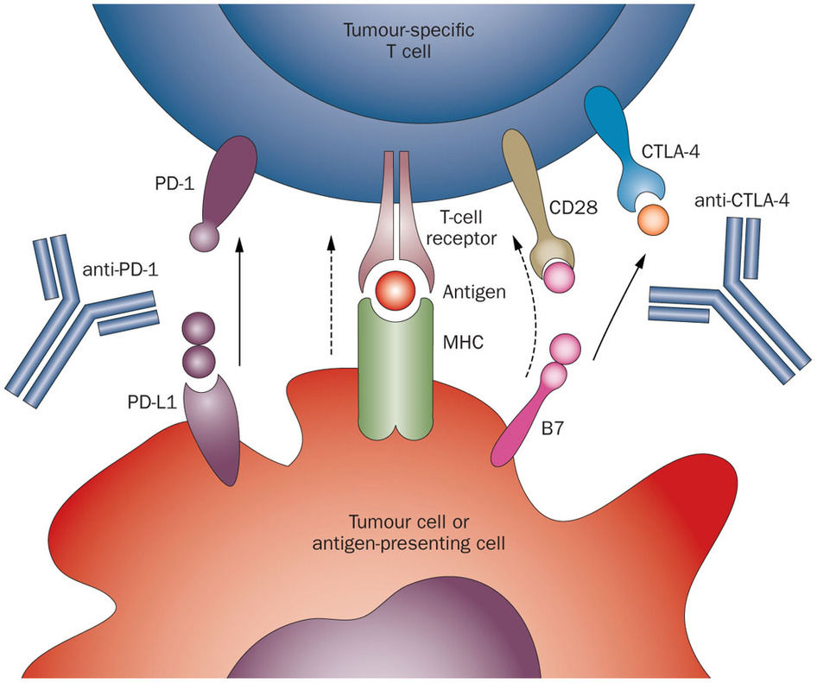
What is Immunotherapy?
Tumours express "checkpoint" proteins on their cell surface to escape detection from the immune system; targeted inhibition towards these receptors enhances T-cell response towards the tumour, these treatments are called Immune Checkpoint Inhibitors [ICI].

Slide 6
Why/how is IO different from chemotherapy/SACT?
Immuno-Oncology (IO) given every 3–4 weeks for up to 2 years (as opposed to up to 4–6 cycle courses) in the best supportive care setting
IO Adjuvant therapy can be given for up to a year
IO’s often have a delayed onset of effect (as it is the T-cells not the drug producing the effect)
Withdrawal of the drug may not lead to cessation of efficacy or toxicity
Less infusion issues compared to chemotherapy/SACT
Different toxicities…….
Drugs stimulate T-cells after which we have no external control over subsequent efficacy/toxicity¹
It can become a perpetuating cycle
Does not terminate spontaneously
SACT, Systemic Anti-Cancer Therapy
1. Li. Protein Cell 2017

Slide 7
Indications for use
Immunotherapy
Melanoma
NSCLC
Renal Cell Carcinoma
Urothelial Malignancies
Head and Neck Malignancies
Hodgkin Lymphoma
Merkle Cell Carcinoma
Upper GI Malignancies
Triple negative Breast Cancer
3040 Clinical Trials

Slide 8
Available regimes - current
Ipilumumab
Pembrolizumab
Nivolumab
Atezolizumab
Cemiplimab
Avelumab
Durvalumab
Tremelimumab
Chemo/IO
Carboplatin/Pemetrexed/Pembrolizumab
Carboplatin/Paclitaxel/Bevacizumab/
Atezolizumab
Carboplatin/Etoposide/Atezolizumab
Carboplatin/Paclitaxel/Pembrolizumab
Abraxane/Atezolizumab
TKI/IO
Avelumab/Axitinib

Slide 9
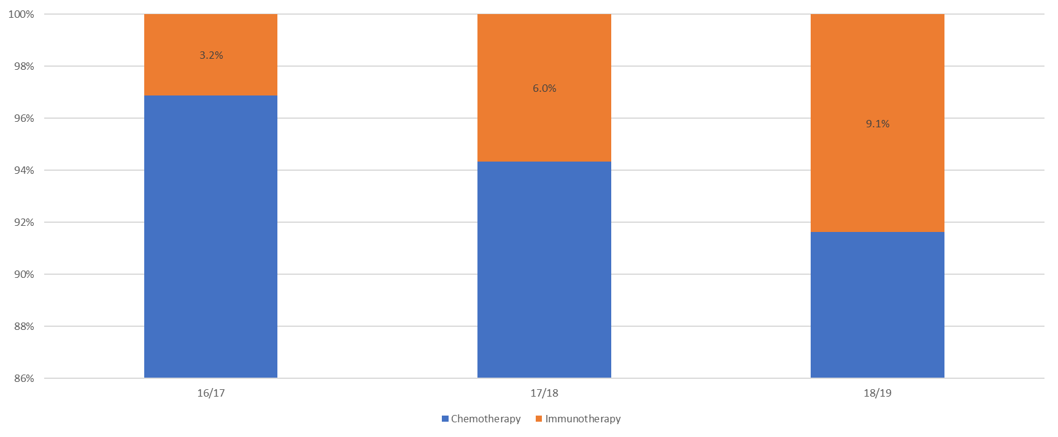
IO at The Clatterbridge Cancer Centre
Time period | June-Dec 2016 | 2017 | 2018 | 2019
Total number of new starters | 64 | 347 | 452 | 620
Olsson-Brown et al Accepted for presentation ESMO Immuno-oncology 2018

Slide 10
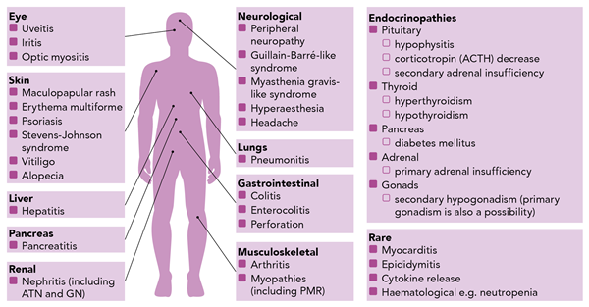
irAE’s
Grade 3-4 Reactions:
CTLA-4¹ 27%
PD-1/PD-L1¹ up to 19%
Combination treatment (CTLA-4 and PD-1/PD-L1)¹ up to 58%
Olsson-Brown, Harker. 2018. Guidelines in Practice

Slide 11
Points to consider with IO toxicity
Vague symptoms
Often only biochemical disturbance for some toxicities
The toxicities rarely resolve on their own and generally need active intervention
Reluctance of patients to report irAEs
Reflare of toxicities and long periods of active management needed to treat toxicities
Withdrawal of the drug ≠ resolution of toxicity
Understanding of the different mechanism of toxicity and the different management strategies
Regular follow-up
Majority of treatment of toxicity can be over weeks to months, but in some cases can be long term
No clear predisposing factors

Slide 13
Mainstay of treatment is steroids e.g. 2mg/Kg IV methylprednisolone or 60mg oral prednisolone
Further immunosuppression often required, now giving infliximab in house
Specialist input

Slide 15
RCC
Nephrectomy (+resection of oligometastatic disease)
Watch and wait (IMDC risk assessment)
Combination immunotherapy
TKI
IO/TKI
Sunitinib, Axtinib, Pazopanib, Cabozantanib
Diarrhoea, PPE, Mucositis, Hypertension, Proteinuria, fatigue, liver dysfunction
mTOR inhibitor- everolimus

Slide 16
Checkmate 214

Slide 17
Bladder Cancer
Most common urological malignancy- 90% urothelial (TCC)
Non muscle invasive/muscle invasive/metastatic
TURBT + intravesical treatment
Radical Cystectomy/ Radical radiotherapy (+/- neoadjuvant GemCis)
Atezolizumab (RR23%, CR11%)*
Palliative GemCis (ORR 49%, mOS 15 months)
Second line Pembro (OS 10vs 7 months, RR 21%)

Slide 18
Summary
Immunotherapy is an exciting (overhyped?) and growing field
Unpredictable toxicities
Mainstay of management is immunosuppression
Toxicities can be serious and irreversible
Management of RCC rapidly changing; difficult to say if we are improving outcomes
Management of bladder cancer more straightforward

Slide 19
Thank you
Questions?

